Slide 1
Why has it
become so
difficult to wear
hijab?

Slide 2
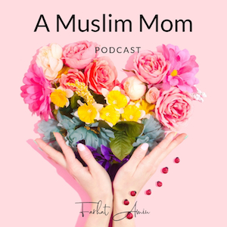
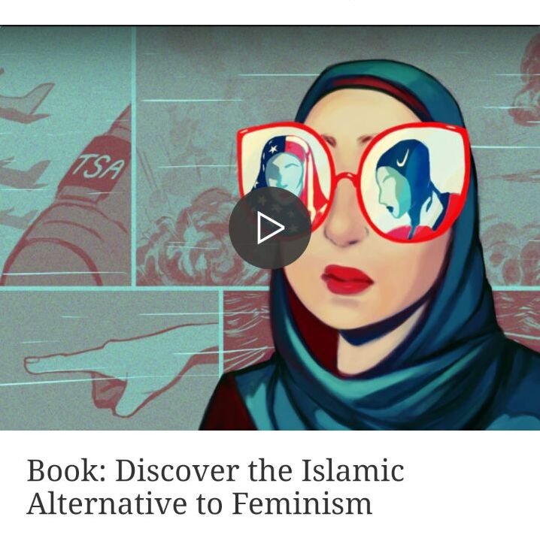
Stay updated about future events
Follow on Instagram farhatamin_uk
A Muslim Mom podcast on Apple podcasts
www.thinkingmuslim.com
Caption
Caption

Slide 3
In the name of Allah , the Beneficent, the Merciful
Why has it become so difficult to wear hijab?
Why the confusion?
Why the hijab is an obligation
The main arguments presented against hijab
How liberalism has influenced our understanding of hijab and modesty
Why Muslim women need to be more confident and more vocal
Session 2

Slide 4
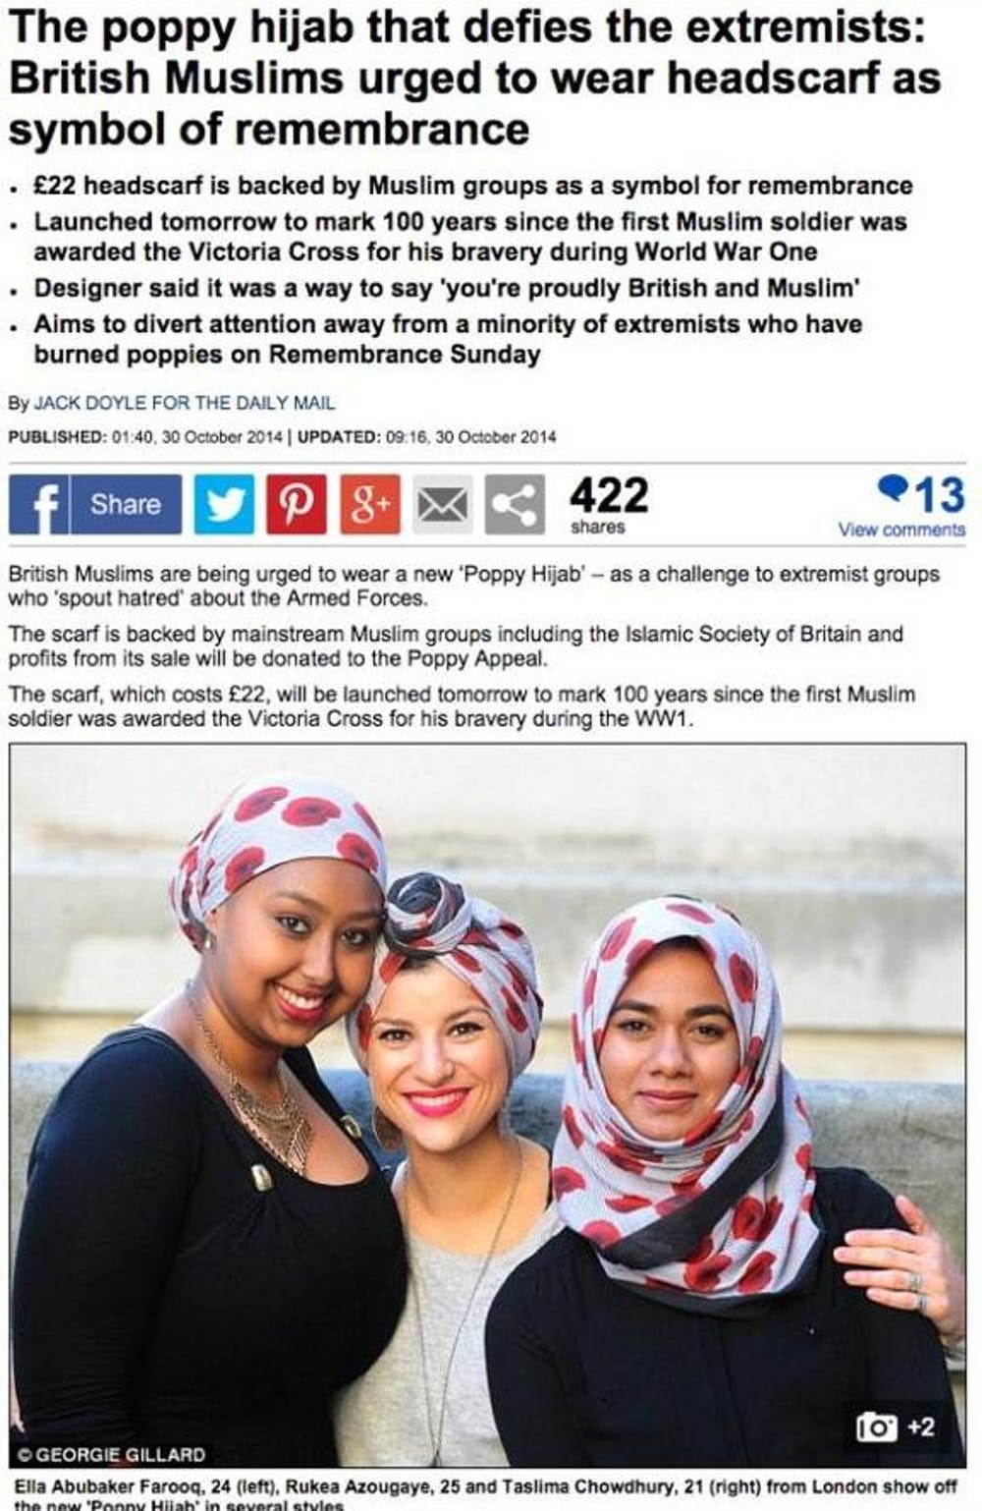
The confusion
The journey to adopt the headscarf and conduct ourselves in a way that is pleasing to Allah is a struggle many Muslim women experience.
Like other requirements of Islam, we experience natural highs and lows regarding our hijab.
Unfortunately, this noble endeavour, to obey Allah, has become particularly difficult for those of us living in western liberal societies.
The growing environment of hostility towards Muslims often places Muslim women and what they should wear as a primary focus of media and political scrutiny.

Slide 5
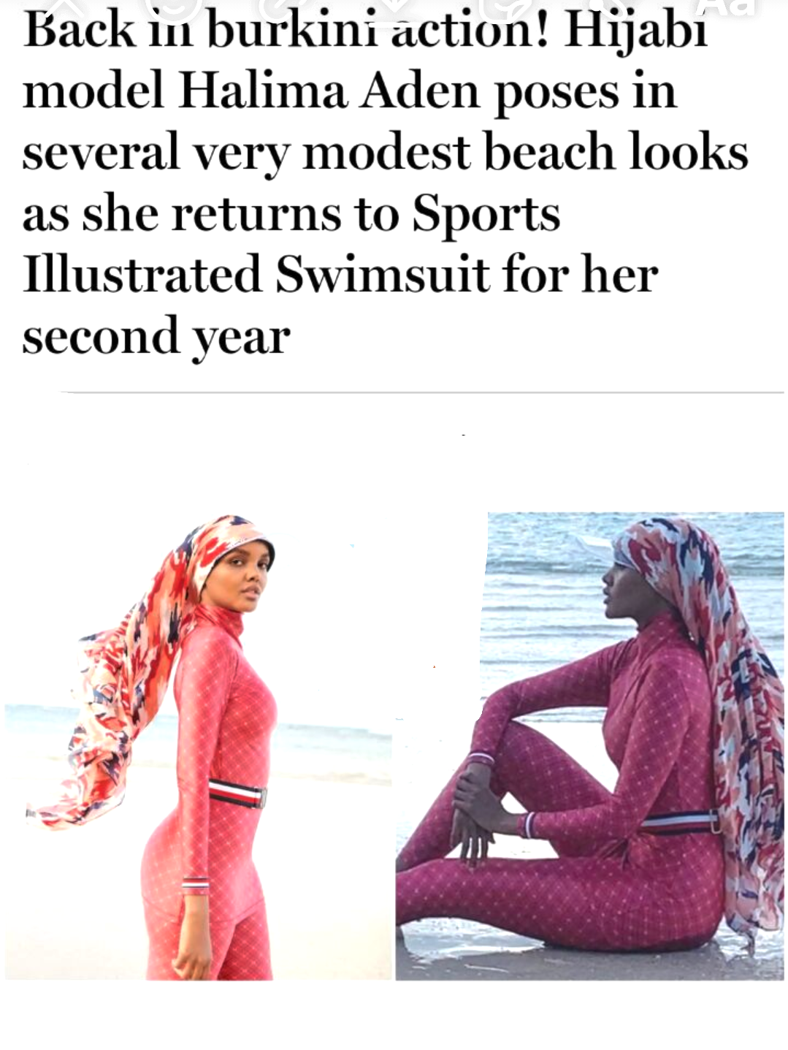
Pressure to fit in
From jibes about ‘letterboxes’ to condescending stories of Muslim women subjugated by a “male patriarchy”. We are often talked about and rarely brought into the conversation unless we agree with their world-view.
In this hostile environment, many Muslim women are the most visible within the Muslim community and those that wear hijab often face overt and subtle discrimination.
To deal with this, we have internalised the hatred and have looked for ways to find acceptance from wider society.
This pressure to fit in has inevitably meant that what we wear has been refashioned to conform to societal expectations of choice and feminism.

Slide 6
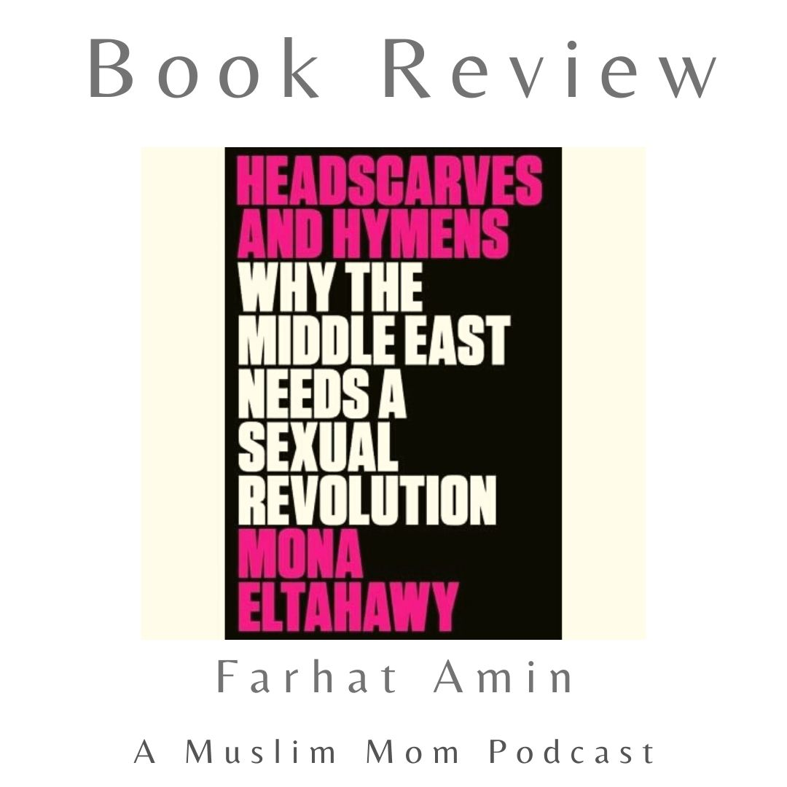
Muslim Feminists
In addition, there is a vocal minority of self-described Muslim feminists such as Samina Ali and Mona El-Tahawi who deny the obligation of hijab.
Their argument is that the hijab is a symbol of a patriarchy and needs to go.
Both have been hailed by broader liberal society as ‘brave’ - yet they feed a centuries old narrative that the ‘brown woman needs to be saved from the brown man’.
Caption

Slide 7
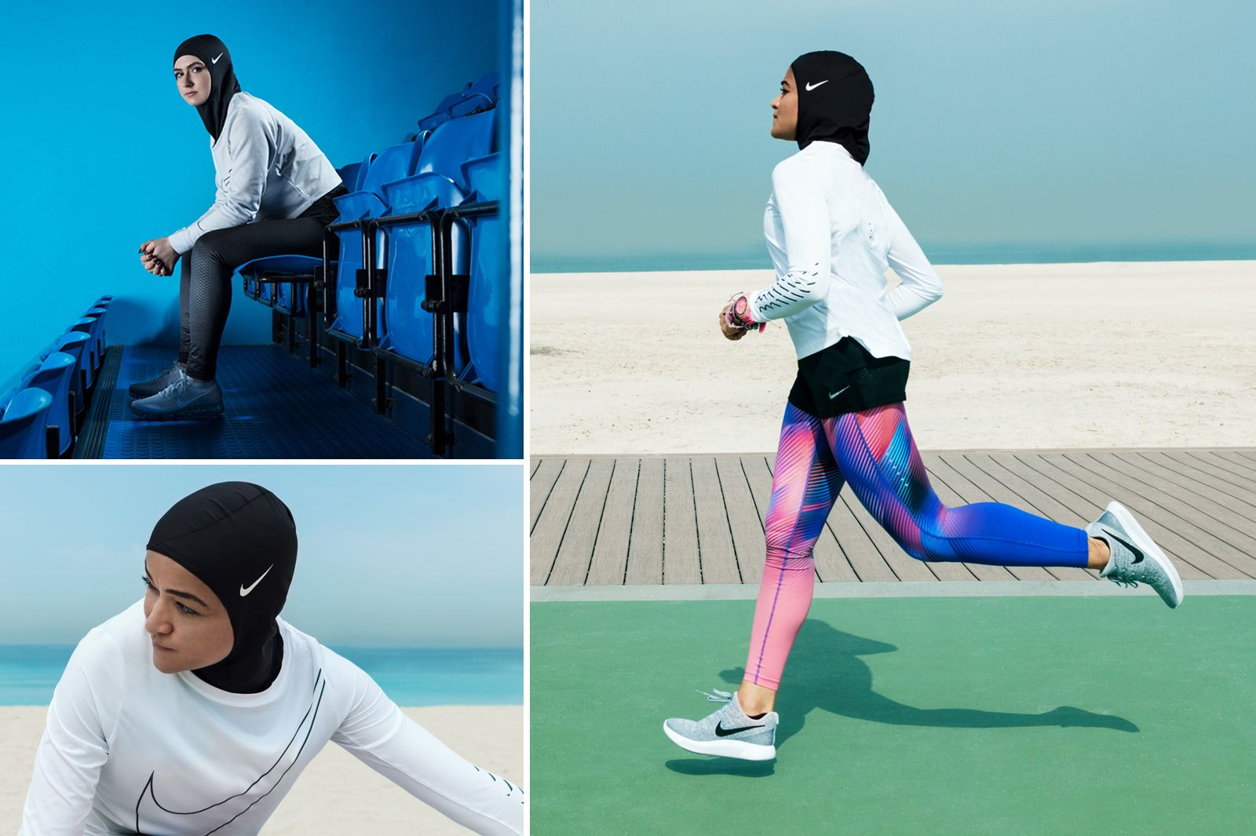
Modest Fashion Industry
To add to this confused atmosphere we have the global fashion industry and the ‘modest fashion’ label - co-opting the hijab into a multi-million pound industry, with an influencer culture that blurs the line between religion and rampant consumerism.
On the one hand we believe that ‘finally we are being recognised and muslim women are being represented’ yet this representation has come as a cost.
Today I want to have a conversation about what we are losing.
How the essence of hijab is being undermined by our anxiety to belong, marketeers, influencers and muslim feminists.
But also I want to explain what the hijab is and how we should view it.
I am not here to stand judgement on your decisions, rather I am here to clarify the correct way of thinking.
Caption

Slide 8
Khimar: The evidences
Let’s first tackle the evidences pertaining to the hijab.
Is there really clear evidences from the Qur’an and Sunnah and what is the room for differences of opinion?
I hope to answer both questions.
Lets start with the head-covering - or what is called the hijab
The head cover or khimar has come in the Qur’an in the following verse:
“And tell believing women that they should lower their glances, guard their private parts, and not display their charms beyond what [it is acceptable] to reveal; they should let them draw their headscarves to fall to cover their necklines and not reveal their charms except to their husbands, their fathers, their husbands’ fathers, their sons, their husbands’ sons, their brothers, their brothers’ sons, their sisters’ sons, their womenfolk, their slaves, such men as attend them who have no sexual desire, or children who are not yet aware of women’s nakedness; they should not stamp their feet so as to draw attention to any hidden charms. Believers, all of you, turn to God so that you may prosper.” (Surah Nur 24:31)
Let’s try to understand this verse and what it is asking us to do.

Slide 9
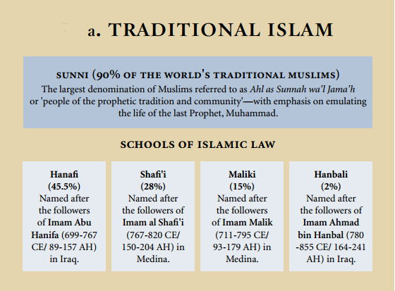
The evidences
The verse starts by saying that women should draw (وَلْيَضْرِبْنَ yudribna) their headscarves (بِخُمُرِهِنَّ khumur) and to allow this cloth to drape so it covers the opening of the neckline (جُيُوبِهِنَّ juyub).
Some translators translate juyub as ‘bosoms’ but it is more accurate to say the neckline - so the cloth deliberately covers the opening between the collar of a garment and the neck.
Essentially the command is to use the headscarf to cover the neck down to the collars.
‘Urwah reported: Aisha, may Allah be pleased with her, said, “May Allah have mercy on the foremost women of the Muhajirun. When Allah revealed the verse, ‘they should let them draw their headscarves to fall to cover their necklines’ (24:31) they cut their sheets and veiled themselves with them.” Ṣaḥīḥ al-Bukhārī

Slide 10
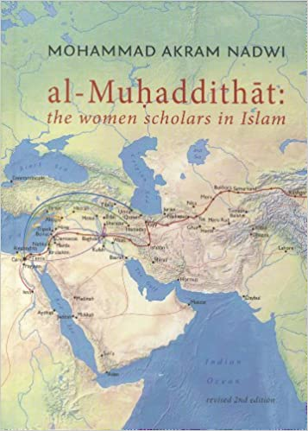
The evidences
The word ‘head-covering’ ( singular khimar, plural khumur) as we will discuss later, is a word only used to describe a head cover.
The verse says and not to ‘display their charms beyond what [it is acceptable] to reveal’.
Ibn Kathir said, “It is possible that Ibn Abbas and those who followed him intended by the explanation of the verse, “beyond what [it is acceptable],” (24:31) to mean the face and the hands, and this is the well-known opinion among the majority.”
So the majority of scholars accepted this.

Slide 11
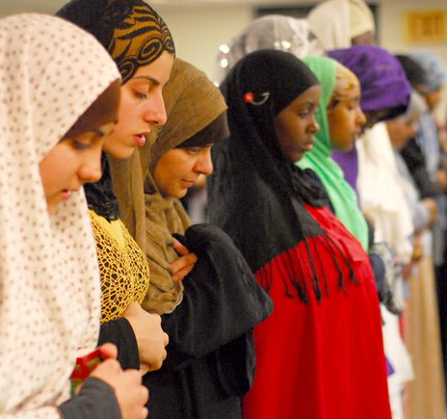
The evidences
The places of ‘charms’ are those places where a woman would place earrings, rings, ankle bracelets and bracelets.
So this verse is saying cover up in public and in front of non-mahrem your ears, neck, lower legs except those places of charms that are allowed to remain uncovered, which are the face and hands.
The evidence for this comes in the following Hadith: Aisha reported: Asma’ bint Abi Bakr entered the house of the Messenger of Allah, (saw) while she was wearing a thin garment and she showed it to him. The Prophet said, “O Asma, when a woman reaches the age of maturity, it is not proper for her to show anything but this and this,” and the Prophet pointed to his face and hands. Sunan Abī Dāwūd

Slide 12
The evidences
The ayah also starts off with the letter “lam,” which is called “lam al-amr.” In Arabic when Lam al-amr, is used as a prefix to a present tense verb, such as “yadhribna,” (to draw - وَلْيَضْرِبْنَ) makes the verb an imperative, that is, a command.
It is not understood as a recommendation, but a specific command directly from Allah Most High to His slaves among the believing women.
This linguistic device is used throughout the Qur’an and is the ‘qarain’ or indicator to show something is compulsory.

Slide 13
The evidences
Allah (swt) at the end of the verse states, “Believers, all of you, turn to God so that you may prosper” as a reminder to tell a Muslim how they should think.
Turning to God means to seek Allah’s guidance.
Is there a difference of opinion? On the fundamentals above no there is not. We cannot find a single scholar from the mujtahid imams that differed on this interpretation.
Remember they differed on a range of issues but not on the obligation to cover the hair.
But there are differences on whether the feet (Hanafis) is part of the exemptions. Also some argued the face should be covered.
There are also legitimate differences on the colour of the khimar, most say it is settled by the custom (urf) of the community.

Slide 14
Khimar - can it be subject to
interpretation?
Samina Ali claims that the word ‘khimar’ is open to interpretation and it means ‘to cover’ so as long as she dresses modestly that fulfils the verse.
This is an erroneous interpretation and lacks credibility and contravenes the known linguistic meaning of Arabic words.
The word khimar linguistically means a covering of the head. It was used to describe such a covering before Islam and the word has been used to describe the head covering of men.
Samina Ali

Slide 15
Khimar - can it be subject to interpretation?
It was one of the names for their turban if it was extra-long and went down to the middle of the belly.
Umm Salamah reported that: “The Prophet used to wipe over the shoes and khimar”. (Muslim)
Ibn Manzoor comments: ‘She meant the “turban” because a man covers his head by it as a woman does the same by her khimar.’
It is reported that when one of the daughters of the Prophet (saw) died he was handing them the clothes to wrap her. The Hadith says: “Then he gave us the Der’a (shirt) followed by the khimar (head cover) then the malhafah (The last piece to wrap the entire body)” (Ahmad & Abu Dawood)

Slide 16
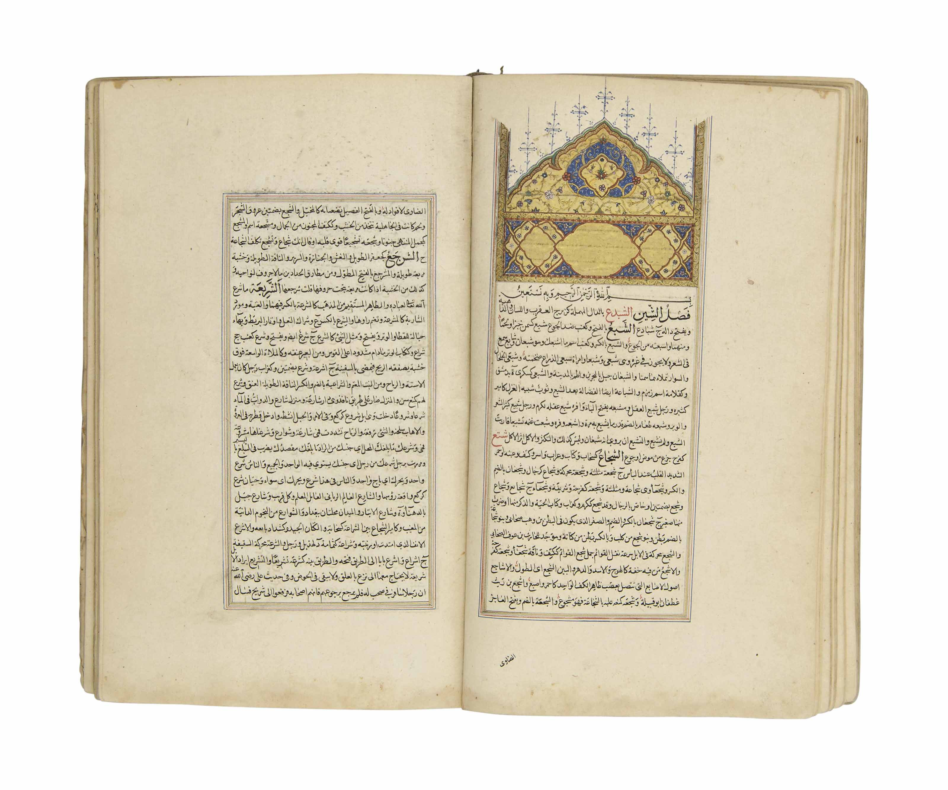
Khimar - can it be subject to interpretation?
The Prophet (saw) said: “Allah does not accept the prayer of any woman who menstruates unless (she wears) a khimar.” [What is meant by a “woman who menstruates” here is a woman who has reached the age of menstruation, not a woman who actually has her menses.]
If this argument was genuine then the same word is used for prayer, that means why cover the head in salah? Why not then dress modestly and uncover the hair in prayer?Dont’ selectively use evidences.
The word khimar is a word of well-known signification among scholars of Arabic, at their forefront the authors of the classical lexical reference dictionaries like Zabidi’s encyclopedic Taj al-‘arus or Mutarrizi’s al-Mughrib, both of which define khimar as ‘a woman’s head-covering’;
or Fayumi’s al-Misbah or Fayruzabadi’s al-Qamus, which both define it as ‘a cloth with which a woman covers her head.’
Fayruzabadi’s al-Qamus

Slide 17
Khimar - can it be subject to interpretation?
The Taj al-‘arus also notes that a man's turban is sometimes referred to as a khimar ‘because a man covers his head with it in like manner as a woman covers her head with her khimar when he disposes it in the Arab manner, turning part of it under the jaws nearly in the same manner in which a woman disposes her khimar.’ These authorities are cited in the eight-volume Arabic-English
The words and sentences of the Qur'an are interpreted according to their linguistic and Sharee‟ah meanings: it is incorrect to interpret them in any other way.
Fayruzabadi’s al-Qamus

Slide 18
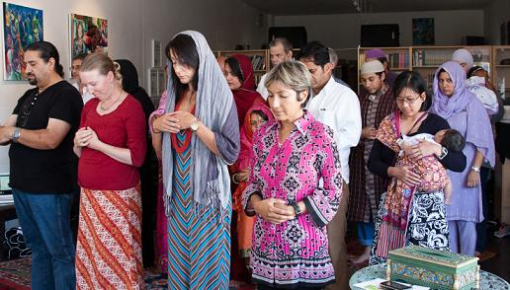
A modernist interpretation
“This is why Muslim women cover their heads: because the Qur’an unambiguously orders them to, and there is no qualifying text or hadith or even other lexical possibility to show that the Qur’anic order might mean anything besides obligation. Rather, the hadiths all bear this meaning out, Muslim scholars are in unanimous agreement about it and have been from the time of the Prophet (saw) down to our own day, and it is even known by all non-Muslim peoples about them.” Sheikh Nuh Ha Mim Keller
The Muslims who seem to be anti-hijab are mainly progressive Muslims who clearly state they want to reform Islam.
"I think Shariah [law] is totally made up, Zonneveld. "It's not like there's a page in the Quran that says, 'For you to be Muslim, you have to live by these set of rules.’ Ani Zonneveld, Muslims for Progressive Values
Muslims for Progressive Values

Slide 19
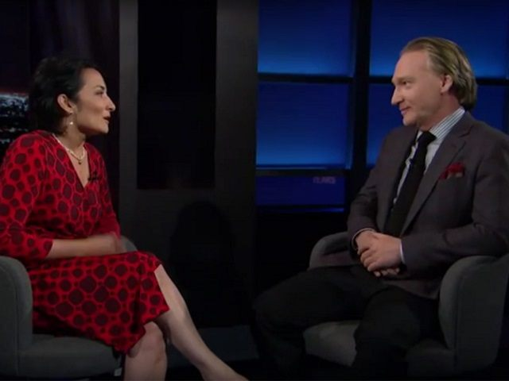
A modernist interpretation
“Today, in the 21st century, most mosques around the world, including in the United States, deny us, as Muslim women, our Islamic right to pray without a headscarf,” Asra Nomani
'Let's look at the text of the Quran and see what Allah and his messenger want us to do rather than to project our ideas onto the text, Muslims firmly believe the Quran is the book of Allah and the speech of Allah.” Yasir Qadhi
Asra Nomani
Muslim Reform Movement
Caption

Slide 20
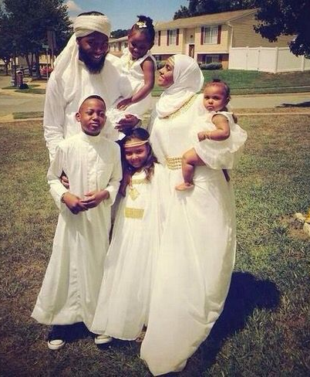
The Jilbab
There is another obligation set out in the primary texts (Qur’an and sunnah) and that is of the wearing of the jilbab.
The ayah says, “Prophet, tell your wives, your daughters, and women believers to make their outer garments hang low over them so as to be recognised and not insulted: God is most forgiving, most merciful.” [33:59]
It has been narrated on the authority of Umm Atiyyah (ra.): “We were ordered to bring out our menstruating women and veiled women in the religious gatherings and invocation of Muslims on the two 'Eid festivals. These menstruating women were to keep away from prayer, witnessing the blessing and call to the Muslims. I asked: “Oh Messenger of Allah! What if one of us does not have a jilbaab?” He said, “Let her wear the jilbaab of her sister.” [Reported by Muslim]

Slide 21
The Jilbab
This means that she did not have a garment to wear over her clothes to go out in; so the Prophet (saw) ordered her to borrow one from her sister.
The verse makes it clear that Allah (swt) has requested the Prophet (saw) to tell his wives, and the wives and daughters of the Muslims, to wear loose garments over their normal clothes which drape down.

Slide 22
The Jilbab
The jilbaab is a cover (milhafah) used to conceal a dress and other items of clothing
It is stated in the al-Qamus al-Muheet (The Arabic Dictionary Al-Qāmūs al-Muḥīṭ was compiled by Muḥammad b. Ya’qūb al-Fayrūzābādī (d. 817 AH) that the jilbab is in the form of the (sirdaab) or the (sinmaar), which is the gown or a loose garment for women, or that which conceals her clothing like a cover (milhafah).
Al-Jawhari stated in as-Sihah (another dictionary) that the jilbab is the cover (milhafah) and some say it is a sheet (mulaa`ah).
There are differences amongst the Ulema about the length of the jilbab and how far should it ‘drape’ but not about the necessity of a loose-fitted outer garment when a woman is in public.
The jilabab is thus an overcoat or a cloak that covers the home clothes.
I can send you more evidences on this if you want later inshallah.

Slide 23
Common arguments against the wearing of hijab
We have discussed the problematic use of the word ‘khimar’ by Samina Ali in her now infamous TedX speech.
Some say the word ‘hijab’ is not mentioned in the Qur’an. This is lazy, as I said, the word ‘khimar’ is the word used in the Qur’an.
It’s true in the Quran the word hijab does not mean head-cover. Its literal meaning in Arabic is curtain. It also means hiding, obstructing and isolating someone or something.
In the past the Arabs did not use the word hijab when referring to head-cover.

Slide 24
Common arguments against the wearing of hijab
In modern times it has become synonymous with head cover and we all use it now. But it is correct to say it was never historically used to describe the cloth to cover the hair.
Another argument that is used is that in the west if you are openly seen to be Muslim you will be subject to discrimination and even attack.
So an analogy is made with eating pig when you are starving, if Islam allows us to eat pig out of necessity then we can also dispense with the hijab?
Such an understanding is erroneous and I am going to explain why.

Slide 25
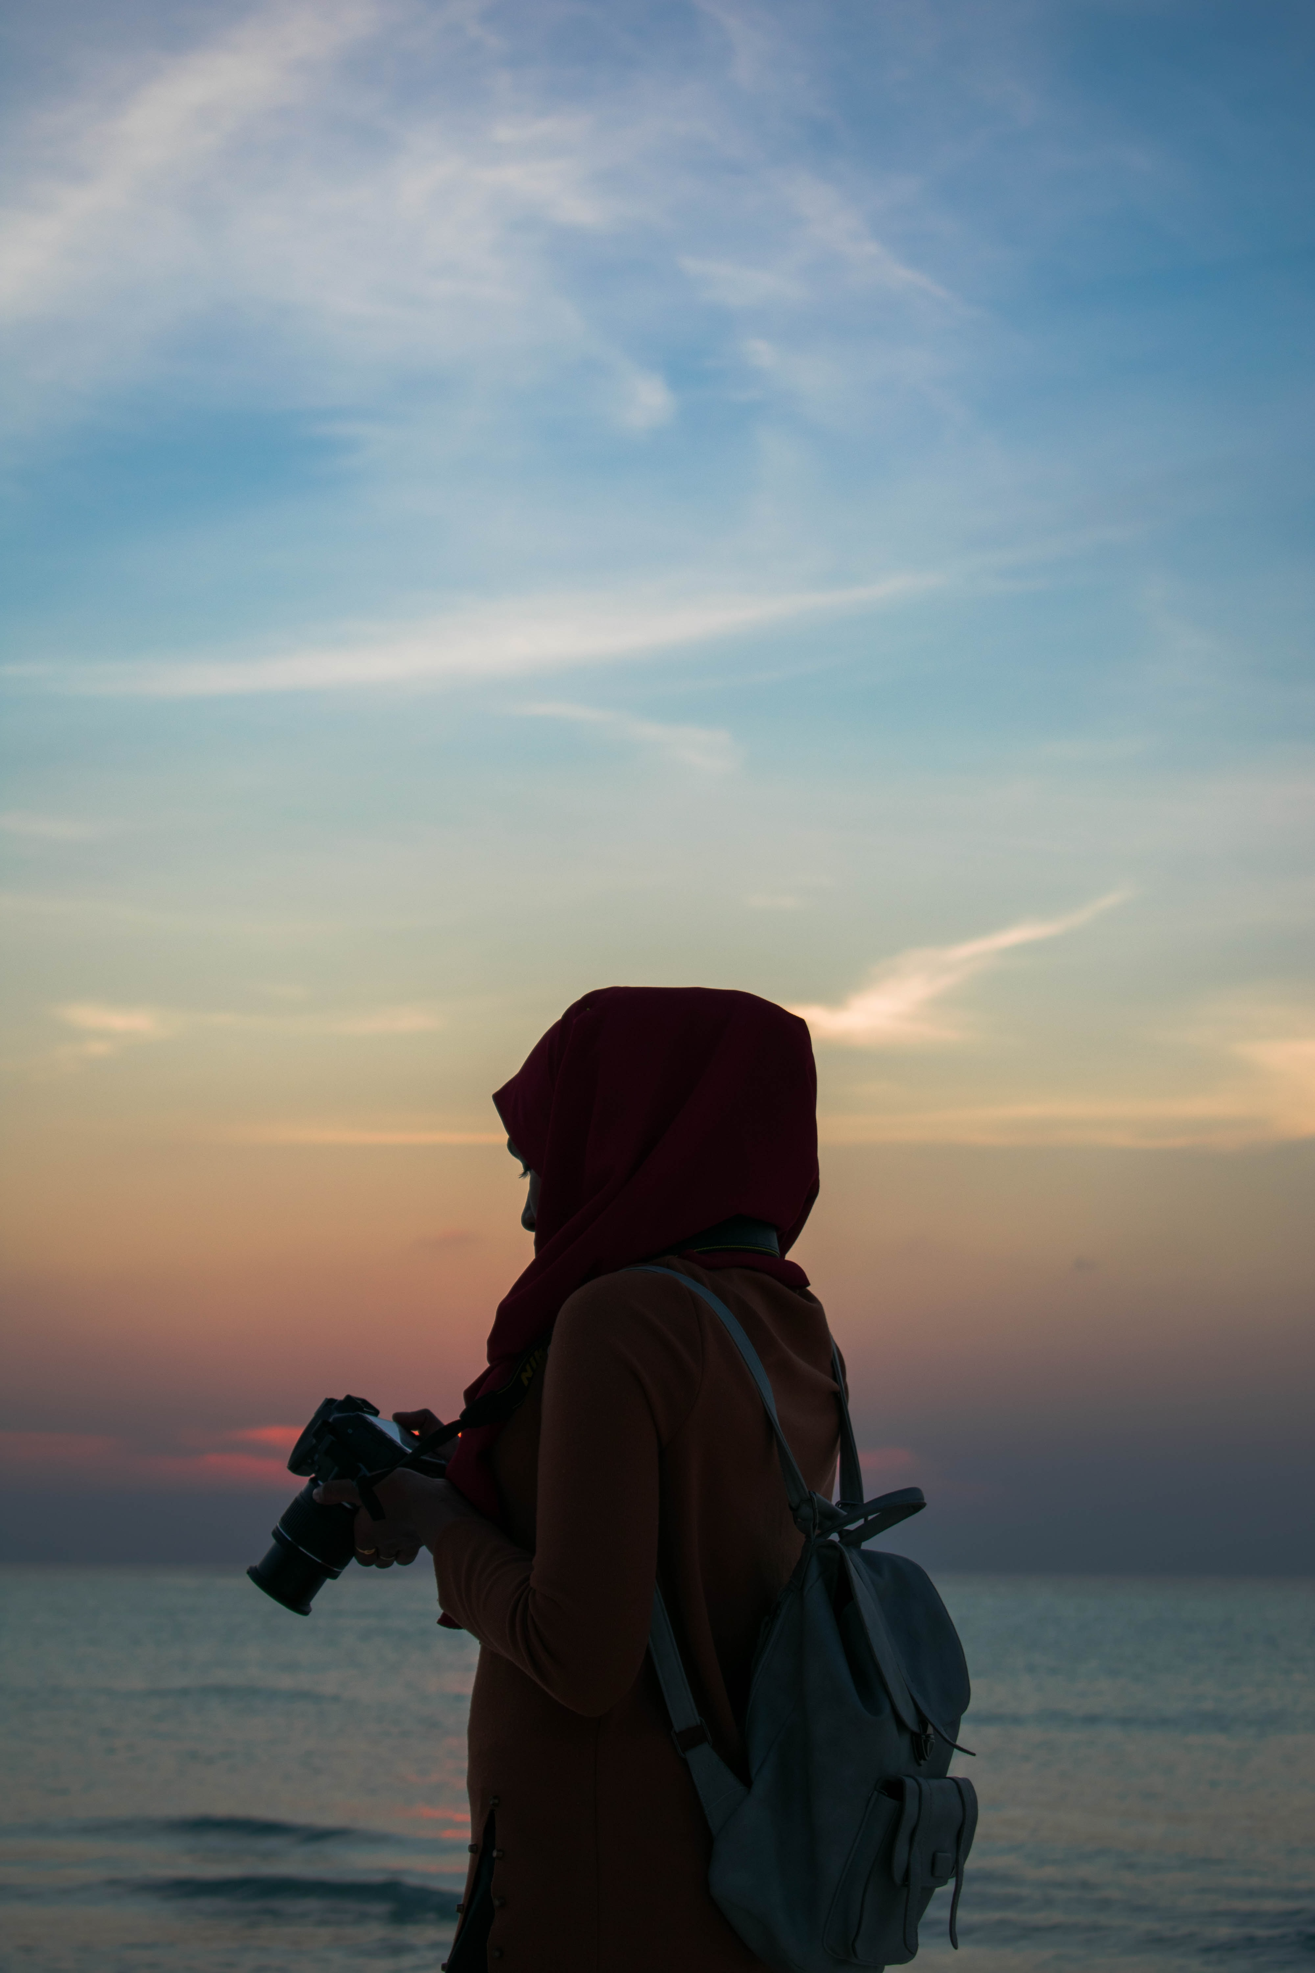
Dhurura (necessity)
Some Muslims are telling sisters that it is acceptable not to wear hijab if they fear they are going to be harassed or if they have been the actual subject of harassment.
They argue that if the headscarf causes women to stand out and puts them in the way of harm and if uncovering the head is not considered socially immodest in general society then it is permissible for Muslim women to not wear the headscarf.
They are loosely using the principle within Islamic law of (dharura) that “dire need makes what is ordinarily prohibited temporarily permitted.”

Slide 26
Dhurura (necessity)
Although this is a well established principle, it has been misapplied in this circumstance.
Sisters facing hostility assume it’s permissible to stop wearing hijab based on its appropriate use.
Some modernist scholars have cited fear as an excuse for abandoning the Islamic rules.
Firstly, I want to clarify how we should be reacting to harassment we face as Muslims.
Secondly, I will address how we should correctly apply this Islamic principle of dharura and cope with the confusion and fear we feel due to the behaviour of islamophobes and racists.

Slide 27
Responding to difficulties
Fear is extremely subjective. When we feel scared how can we measure our fear?
Are our fears just imagined or legitimate fears? We may ask ourselves, “How do I know if the fear that I feel gives me the ruksa or licence to do things that are ordinarily prohibited? Or to abandon things that are usually an obligation?”
For example, we may fear praying salah or saying salam back to someone that greets us, are we allowed to abandon Islam on fear alone?
In its essence, fear alone is not an adequate permission to abandon the shari’ rules

Slide 28
Responding to difficulties
Allah says, “And We will surely test you with something of fear and hunger and a loss of wealth and lives and fruits but give good tidings to the patient.” (2:155)
So the glad tidings Allah has given us is that if we remain patient, that is pursue his path with constancy, then we are rewarded.
The practice of the Sahabah is enough to prove that ‘belief’ is going to come with tests.
Allah (swt) says, “Do the people think that they will be left to say, "We believe" and they will not be tried? But We have certainly tried those before them, and Allah will surely make evident those who are truthful, and He will surely make evident the liars.” [29:2,3]
Then Allah says, Those who exert themselves do so for their own benefit––God does not need His creatures. We shall certainly blot out the misdeeds of those who believe and do good deeds, and We shall reward them according to the best of their actions.[29:6,7]

Slide 29
Understanding dharura (necessity) in Islam
A principle in Islamic law explains that “dire need makes what is ordinarily prohibited temporarily permitted’ for that particular individual.
What is considered ‘dharura’ is an absolute dire need or being forced into a situation of dire need where there is a danger to ones life and limb.
Is verbal abuse enough to evoke the Islamic permission of dhurura? Firstly, the scholars say harm is of different levels. When it comes to verbal insults and derogatory comments, should we let the ignorant, backward actions of racists and islamophobes dictate to us how we are going to practice our faith?
The rukhsa is a temporary license in the following situations:
When the insults reach a level of systemic violence
There is a genuine fear for your life because you are a Muslim
It becomes a norm and you have no legal protection and you will be attacked

Slide 30
Understanding dharura (necessity) in Islam
However this can only apply when it is impossible to leave the place in which you are being repressed, like the Uyghur Muslims.
"Was not the earth of Allah spacious [enough] for you to emigrate therein?" (4:97) - Allah will account those that abandoned their faith instead of leaving the land of persecution.
“As for the helpless men, women and children who have neither the strength nor the means to escape, For those it is expected that Allah will pardon them, and Allah is ever Pardoning and Forgiving. And whoever emigrates for the cause of Allah will find on the earth many [alternative] locations and abundance (4:99-100).

Slide 31
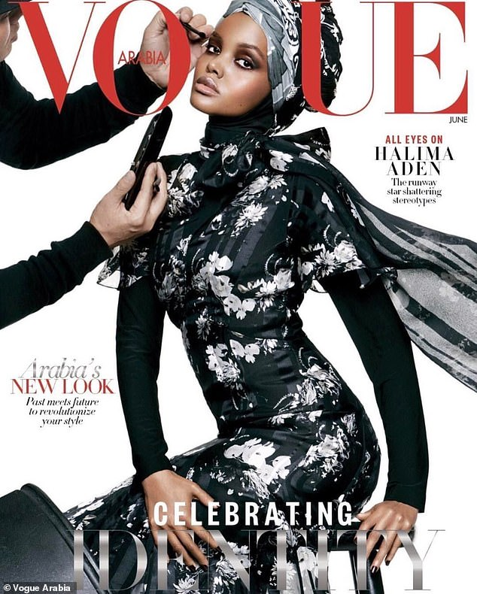
Modest Fashion
‘Modest fashion’ is a term that is used to describe the industry surrounding hijab fashion.
It was developed by brands as a way to market Muslim dress.
But like all aspects of the modern fashion industry, the hijab has been reduced to an accessory.
And like the the fashion industry, to sell modest fashion, the woman behind the hijab has been objectified.
A lot of (not all) modest fashion revolves around selling an image of hijab that contradicts the aforementioned ayat and the clear rules about tabarruj (drawing attention) and showing ones beatification (zeena).

Slide 32
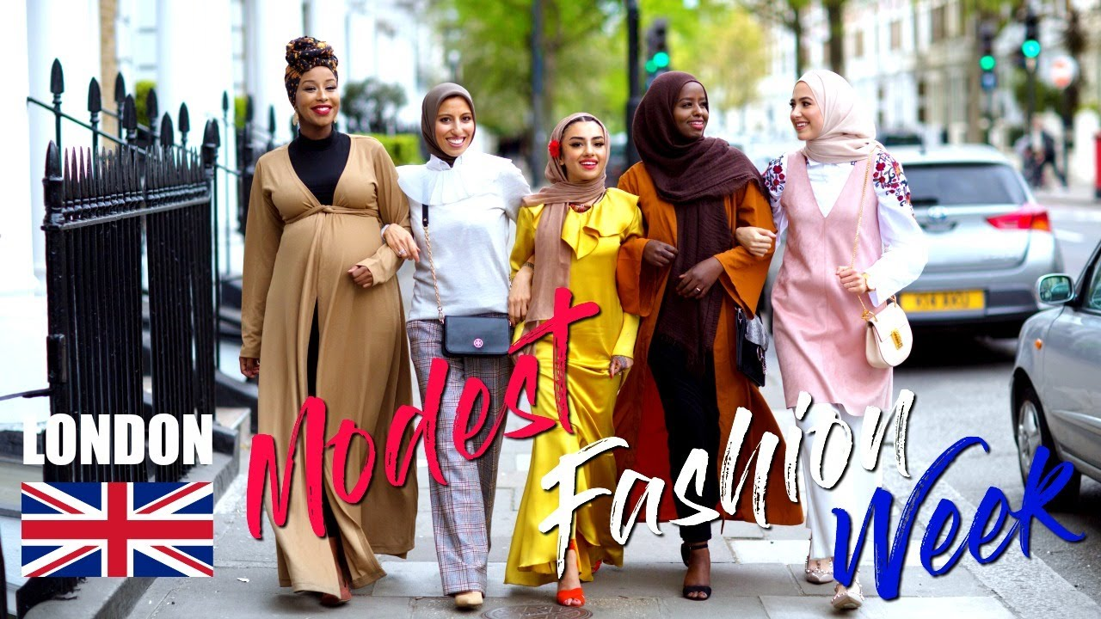
Modest Fashion
Like women have been subject to commodification in general life, Muslim women have been sold the same repression.
Sadly, those young Muslims that would associate themselves as Muslim feminists are falling pray to an industry that wants to objectify them.
In the process the hijab loses its meaning.
Many Muslim women that see through this unfortunately then make a link between hijab and hypocrisy and this complicates in their mind the need to wear the Islamic dress.

Slide 33
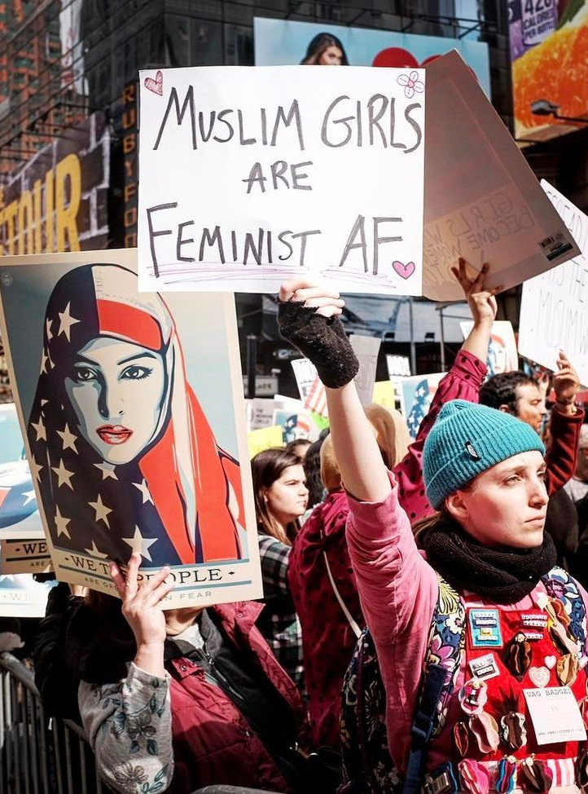
The real reason behind the confusion- liberalism
Why is it that in modern times the hijab, which was a given for centuries, has now become subject to so much confusion?
To understand this we have to take a step back and appreciate the last century and the half.
Since the middle of the 19th Century, Muslims have been subject to a ‘liberal inquisition’, we have been made to feel deficient and backwards when adhering to Islam.
The Europeans (initially) sought to undermine our societies by questioning aspects of our faith and seeking to force a type of inferiority complex.
This was so they could colonise the Muslim world.

Slide 34
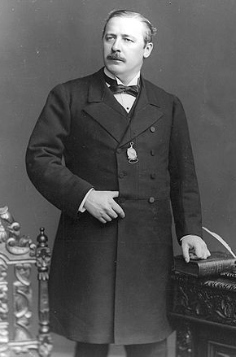
The real reason behind the confusion- liberalism
Lord Cromer, for example, the British Consul General in Egypt from 1883 to 1907, was convinced of the inferiority of Islamic religion & society, & the “inferior mind of the Oriental”.
It was Islam's degradation of women, its insistence on veiling, which was the "fatal obstacle" to the Egyptian's "attainment of that elevation of thought & character which should accompany the introduction of Western civilisation,"
The Egyptians should be "persuaded or forced" to become "civilised" by disposing of the veil.
Hypocritically, Cromer founded and presided over the Men's League for Opposing Women's Suffrage at home.
But in Egypt he called for their liberation.

Slide 35
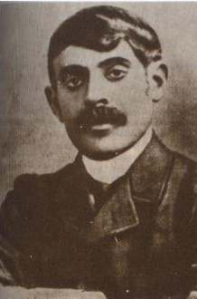
The colonial demoralisation
This was never really to ‘liberate’ women but to undermine the backbone of Muslim society - the family.
Qasim Amin, a French-educated lawyer, wrote a book called The Liberation of Women (1899), he was instructed by Lord Cromer and led the Arab Liberal Party.
It’s submissive in its praise for the West and harsh in its denunciation of Egypt.
Amin argued that Muslim societies had to abandon their backward ways and follow the Western path to civilisation and success.
The European powers left a secular elite in the Muslim world, that scoffed at Islamic practice and were besotted by liberalism.

Slide 36
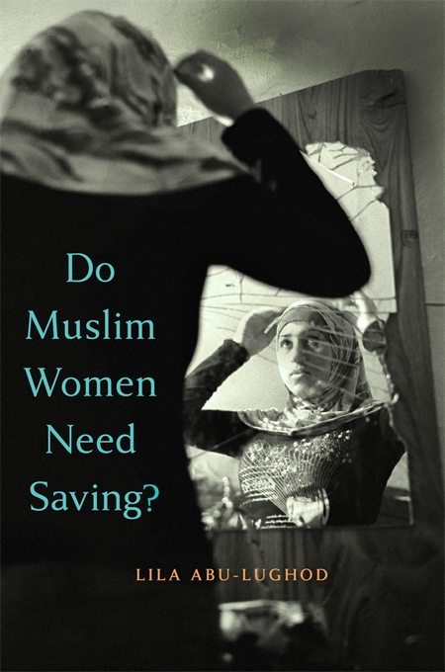
The colonial demoralisation
As one nineteenth-century French official put it, “If we are to strike against Algerian society’s capacity to resist, then we must first of all conquer their women,” adding, “We have to go and find these women, under the veils they hide behind.’ (Lila Abu-Lughod in her book Do Muslim Women Need Saving?)
The French did nothing to help North African women, they had “un-veiling” campaigns during the Algerian War, ( 1954 -1962) under the pretext of “liberating women.” The purpose, like the rapes committed by soldiers was to demoralise Algerian men.
The styles may have changed but the intention remains the same. We have to reinstate our Islamic sense of selves.

Slide 37
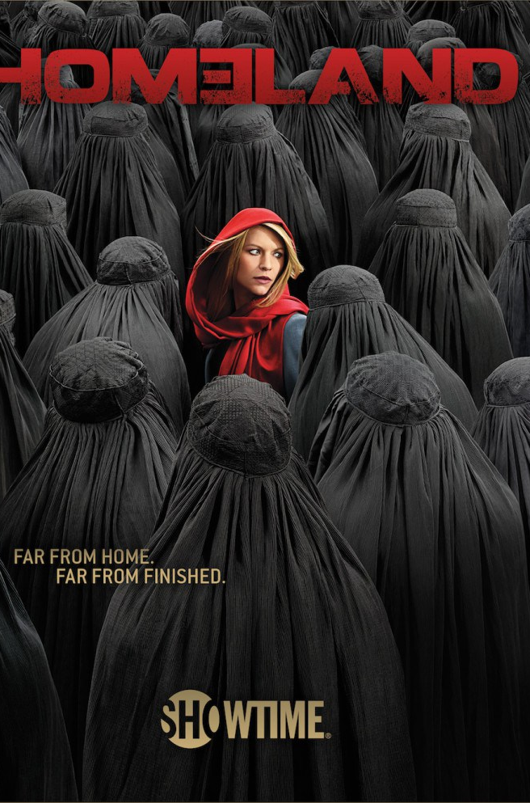
The colonial demoralisation
Ayaan Hirsi Ali is the Qasim Amin of today, having done more than anyone else to malign Muslim majority countries and sing the praises of empire, all the while masquerading as a “feminist.”
"Respect for women... can triumph in the Middle East and beyond!" trilled George Bush to the UN in 2002. "The repression of women [is] everywhere and always wrong!" he told the New York Times, warming to his theme that the west should attack Iraq for the sake of its women.
Just as he bombed Afghanistan to liberate the women from their burkas (to free the "women of cover"), and sent out his wife Laura to tell how Afghans are tortured for wearing nail varnish,

Slide 38
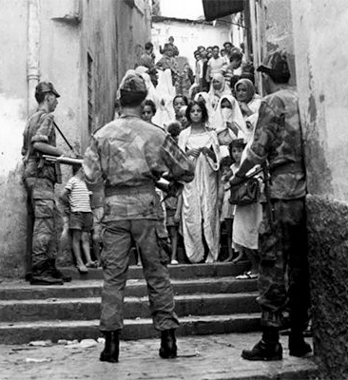
The colonial demoralisation
Bush, used feminist language to denounce the indigenous culture; and, says Ahmed, feminism thus served as a "handmaid to colonialism".
"Whether in the hands of patriarchal men or feminists," she writes, "the ideas of western feminism essentially functioned to morally justify the attack on native societies and to support the notion of comprehensive superiority of Europe.”
Let me be clear, we wear the hijab for one simple reason, to submit to Allah (swt) and not for political reasons. But we must be aware of the political and ideological context within which the ‘liberation’ discourse comes.

Slide 39
Fighting the patriarchy?
It is common to find, especially amongst young Muslims that we must ‘fight the patriarchy.’
Before condemning this, I can appreciate where this sentiment comes from.
The absence of Islam as a basis in our societies has meant that many men have abused women and undermined the many rights Islam gave women.
When colonialism came to the Muslim world, it didn’t just fight us with a liberalism but also created an ultra-conservative backlash.
So you will not get from me an endorsement of some of these unacceptable positions.

Slide 40
Fighting the patriarchy?
However, to fight this we need to reassert our Islamic rights and not all into the trap of denying the roles and responsibilities that come from our Creator.
For sure Islam gave us a right to work, a right to have a public role, a right to property and economic independence (a man is the provider and cannot take a woman’s money).
However Islam also gave us obligations, chiefly to conduct ourselves with modesty and to dress in a fitting way.
In the same way to correct men, we have to assert the timeless roles as set out in Islam, the same applies to us.

Slide 41
Stay updated about future events
Follow on Instagram farhatamin_uk
twitter @farhataminuk
A Muslim Mom podcast on Apple podcasts
www.thinkingmuslim.com
Caption
Caption

